Slide 1

Exploration

Slide 2

Database
A database is an organized collection of data.
The main purpose of database is to operate large amount of information by storing, retrieving and managing.
There are many dynamic websites on the world wide web nowadays which are handled through databases. For example, a model to checks the availability of rooms in a hotel. It is an example of dynamic website that uses database.

Slide 3
Non-RDBMS / NoSQL
NoSQL or Non-RDBMS (Non Relational Database Management Systems) is database that is not modeled like relational model based.
The data structure used by NoSQL databases are different from relational databases. It’s faster and more flexible than relational db. That’s why it’s increasingly used in big data & real time web application.
Here are the example of NoSQL database: MongoDB, Cassandra, CouchDB, OrientDB, IBM Domino, ArangoDB & Apache Ignite.

Slide 4
MongoDB
MongoDB is free & open source cross-platform document-oriented database. It’s classified as NoSQL database & uses JSON-like documents with schemas.
MongoDB has been developed by MongoDB Inc. since 11th February 2009, and is published under GNU Affero General Public License & the Apache License.

Slide 5
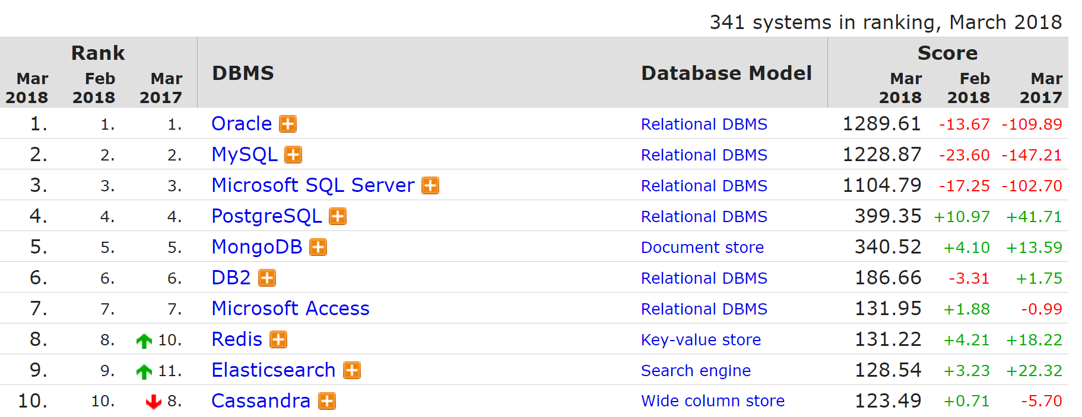
MongoDB Ranking
5th All DB-engines
https://db-engines.com/en/ranking

Slide 6
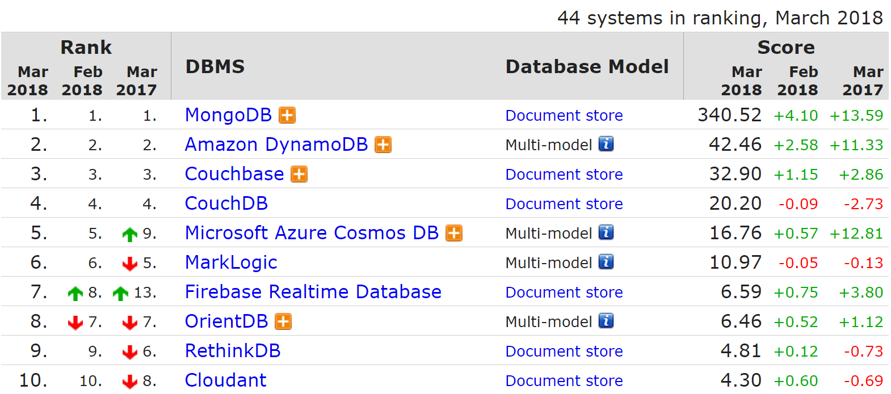
MongoDB Ranking
1st Doc Store DB-engines
https://db-engines.com/en/ranking

Slide 7
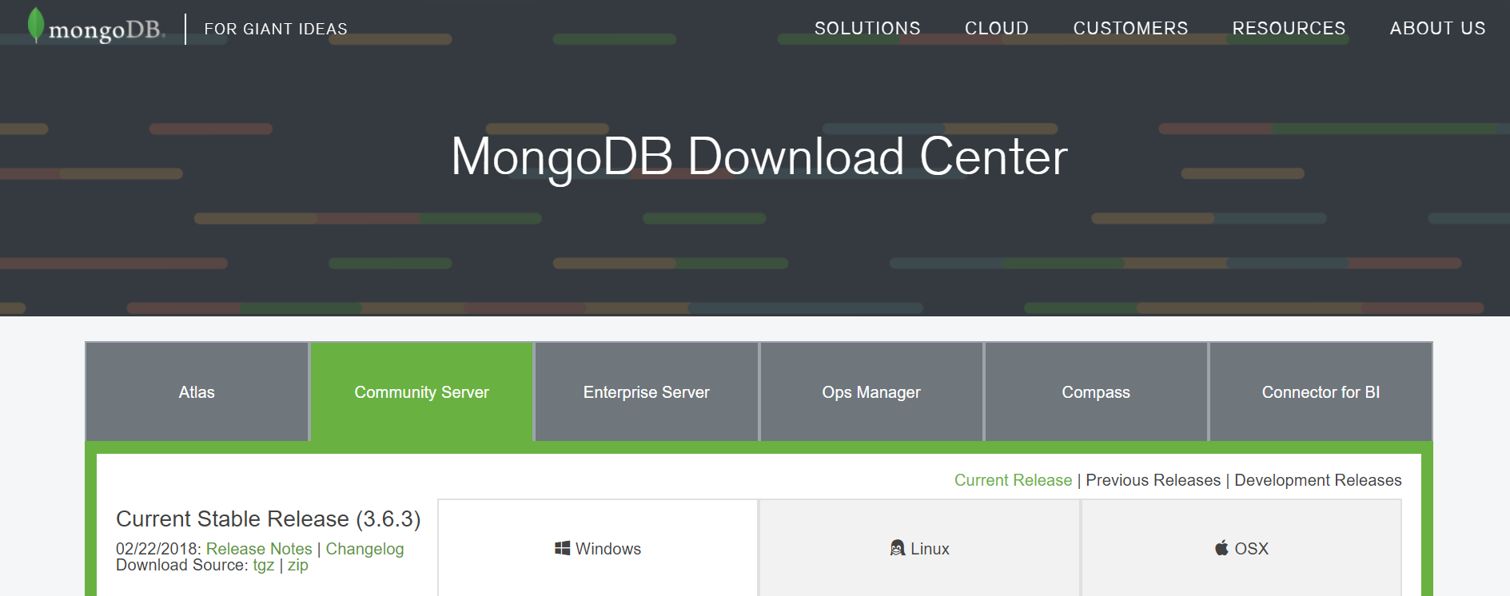
Getting Started
Create data & db folder at C:/data/db
Download & install MongoDB

Slide 8
Activate Server
Open terminal:
$ cd C:\Program Files\MongoDB\Server\3.6\bin
$ mongod --dbpath C:\data\db
$ mongod
If OK, it will show "Waiting for connections on port 27017". Then open new terminal:
$ cd C:\Program Files\MongoDB\Server\3.6\bin
$ mongo

Slide 9


?
How to Work
With MongoDB
Database

Slide 10
Database
Menampilkan daftar database:
$ show dbs
Menampilkan db aktif (default: test):
$ db
Membuat sekaligus menggunakan db “toko”:
$ use toko
Hapus db “toko”:
$ use toko
$ db.dropDatabase()

Slide 11
Collection
Membuat db user:
$ db.createUser({user:"lintang",
pwd:"1234", roles:["readWrite", "dbAdmin"]});
Membuat collection “karyawan”:
$ db.createCollection('karyawan')
Menampilkan daftar collection dalam db:
$ show collections
Hapus collection “karyawan”:
$ db.karyawan.drop();

Slide 12
Add Data Record
Add 1 data JSON ke collection ”karyawan”:
$ db.karyawan.insert({nama:"Adi",usia:24});
Add multiple data ke collection “karyawan”:
$ db.karyawan.insert([
{nama:"Budi",usia:23},
{nama:"Caca",usia:25}]);
Menampilkan data pada collection “karyawan”:
$ db.karyawan.find();
$ db.karyawan.find().pretty();
$ db.karyawan.find({nama: "Adi"}).pretty();

Slide 13
Update
Update semua property data:
$ db.karyawan.update({nama: "Adi"},
{nama:"Adi",usia:21});
Update property data tertentu:
$ db.karyawan.update({nama: "Budi"},
{$set:{usia:26}});
Update nama property:
$ db.karyawan.update({nama: "Caca"},
{$rename:{"usia":"umur"}});

Slide 14
Update Many
Update semua data isinya hanya usia = 21:
$ db.karyawan.updateMany({},{usia:21});
Update semua data property usia = 21:
$ db.karyawan.updateMany({},
{$set:{usia:21}});
Update nama property di semua data:
$ db.karyawan.updateMany({},
{$rename:{"usia":"umur"}});

Slide 15
Remove
Hapus 1 property dari sebuah data:
$ db.karyawan.update({nama: "Adi"},
{$unset:{usia:true}});
$ db.karyawan.update({nama: "Budi"},
{$unset:{usia:1}});
Hapus 1 data:
$ db.karyawan.remove({nama: "Caca"});
Hapus semua data:
$ db.karyawan.remove({});

Slide 16
And & Or
Tampilkan data yang memiliki property value nama = Budi dan usia = 21:
$ db.karyawan.find({$and:
[{nama:"Budi"},{usia:21}]}).pretty();
Tampilkan data yang memiliki property value nama = Adi atau nama = Budi:
$ db.karyawan.find({$or:
[{nama:"Adi"},{nama:"Budi"}]}).pretty();

Slide 17
Lower and
Greater Than
Tampilkan data yang property usianya < 25:
$ db.karyawan.find({usia:{$lt:25}})
.pretty();
Tampilkan data yang property usianya > 25:
$ db.karyawan.find({usia:{$gt:25}})
.pretty();

Slide 18
Lower and Greater
Than Equal
Tampilkan data yang property usianya <= 25:
$ db.karyawan.find({usia:{$lte:25}})
.pretty();
Tampilkan data yang property usianya >= 25:
$ db.karyawan.find({usia:{$gte:25}})
.pretty();

Slide 19
Limit & Skip
Tampilkan 2 data pertama:
$ db.karyawan.find().limit(2);
Tampilkan 1 data setelah 2 data pertama:
$ db.karyawan.find().limit(1).skip(2);
Tampilkan 3 data setelah 3 data pertama:
$ db.karyawan.find().limit(3).skip(3);

Slide 20
Sort
Urutkan data ascending berdasarkan nama:
$ db.karyawan.find().sort({nama:1});
Urutkan data descending berdasarkan nama:
$ db.karyawan.find().sort({nama:-1});
Urutkan data ascending berdasarkan usia:
$ db.karyawan.find().sort({usia:1});
Urutkan data descending berdasarkan usia:
$ db.karyawan.find().sort({usia:-1});

Slide 21
Count
Hitung jumlah data di collection “karyawan”:
$ db.karyawan.find().count();
Hitung jumlah data dg prop nama = Adi:
$ db.karyawan.find({nama:"Adi"}).count();

Slide 22
?
How to Work
With MongoDB
GUI Tools

Slide 23
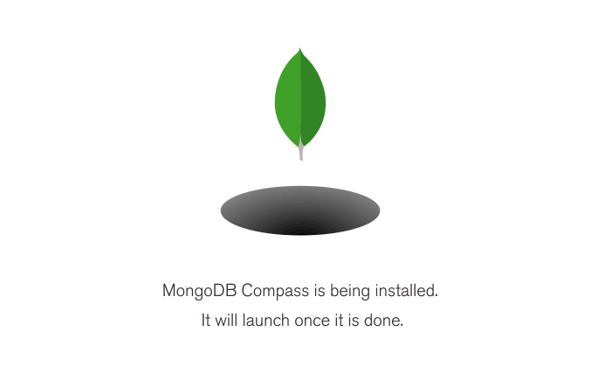
Working with GUI
#1 Installing MongoDB Compass

Slide 24
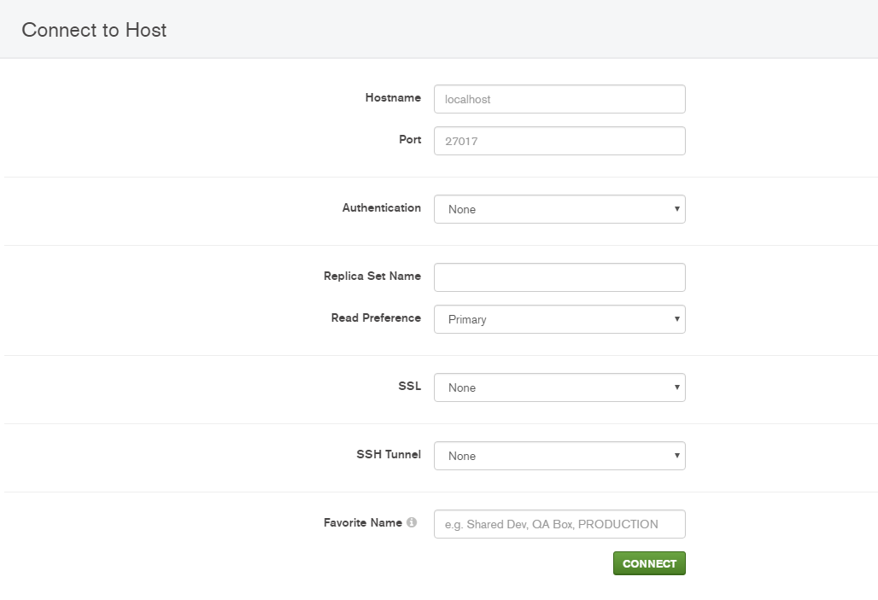
Working with GUI
#2 Connect to Server

Slide 25
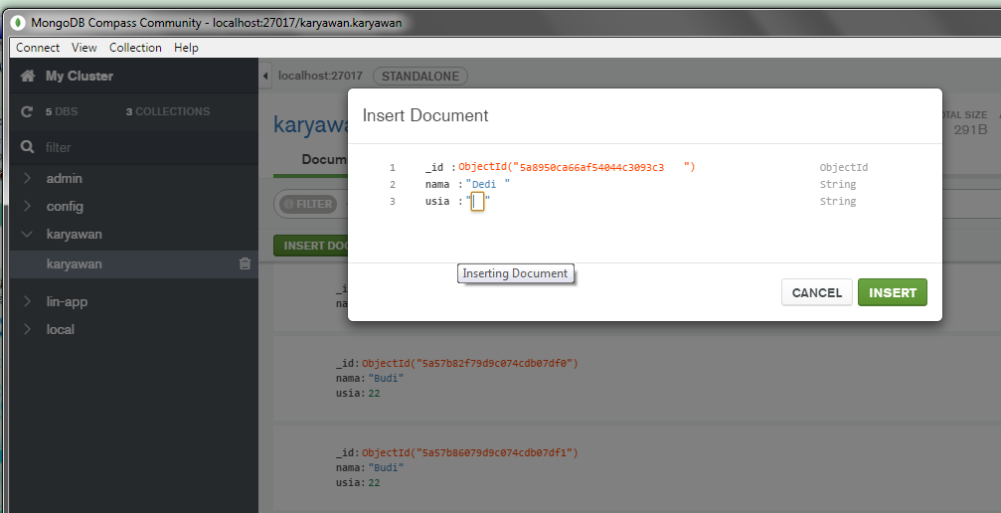
Working with GUI
#3 Explore by yourself!

Slide 26
?
How to Work
With MongoDB
Hosting

Slide 27
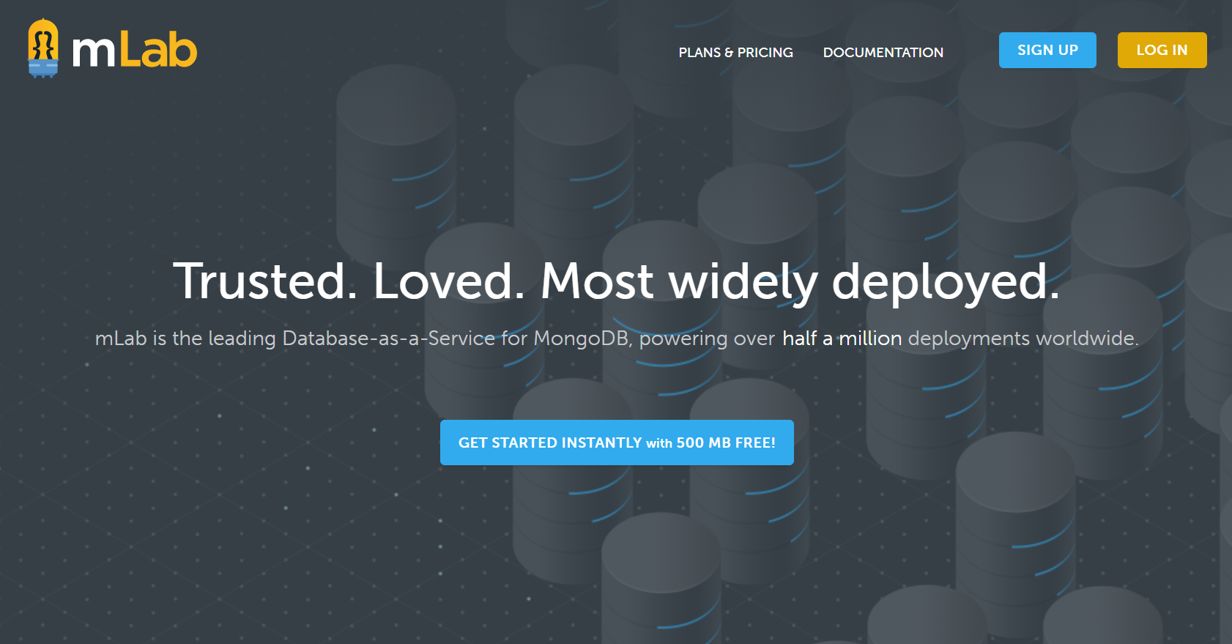
mLab
mlab.com/

Slide 28
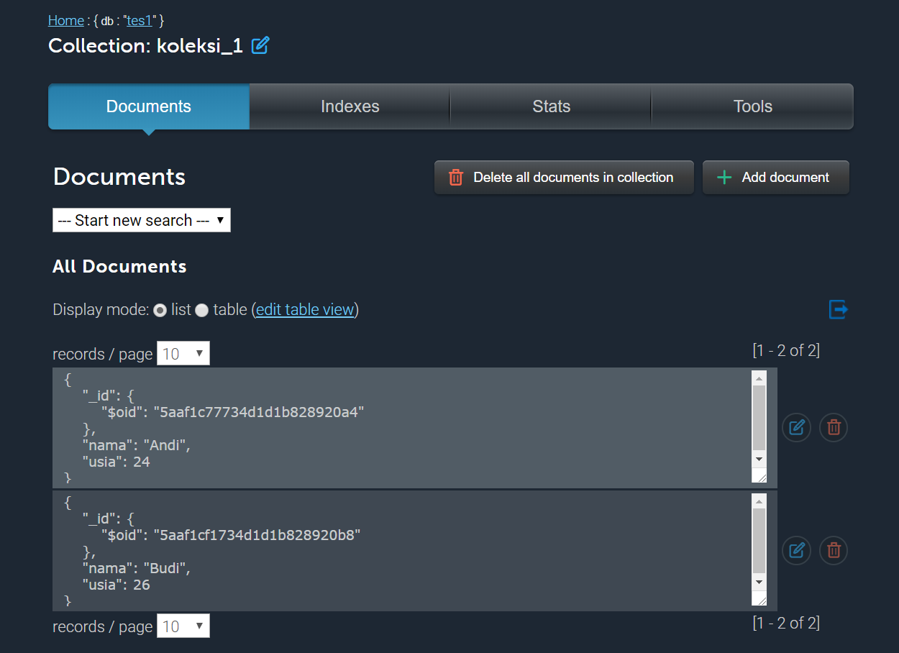
mLab
mlab.com/

Slide 29
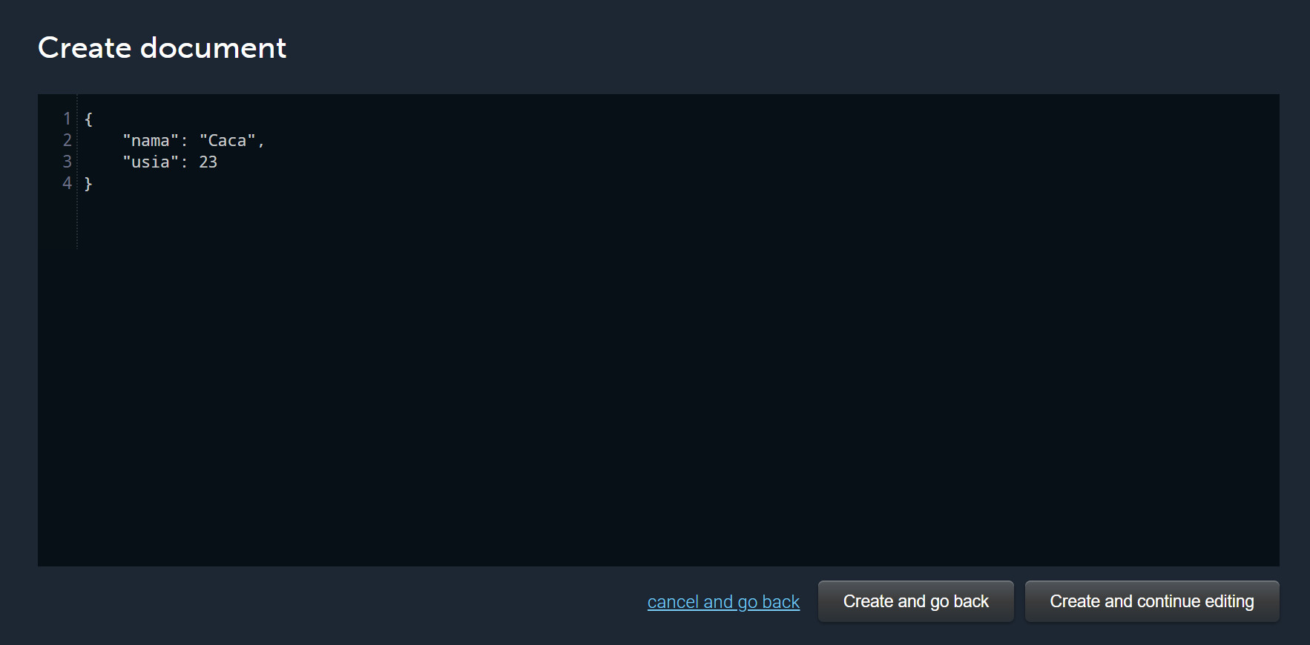
mLab
mlab.com/

Slide 30
Exploration

